Slide 1
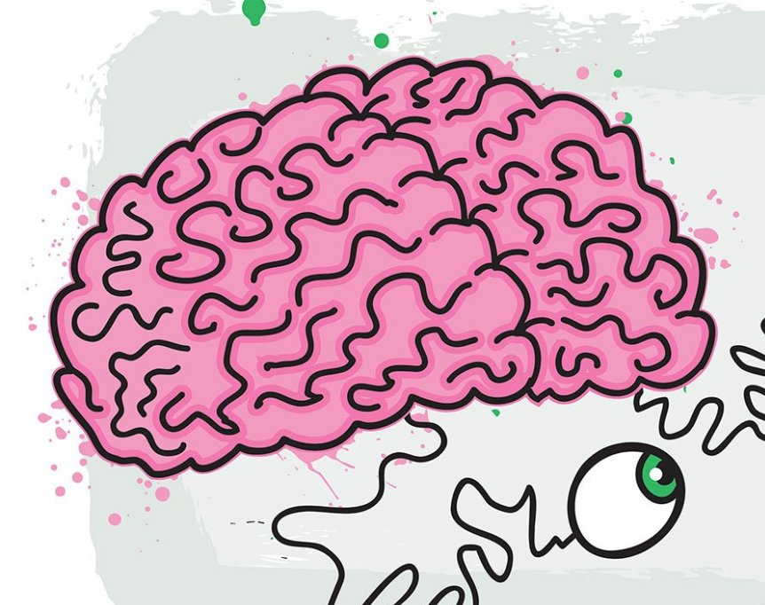
Brain Teasers

Slide 2

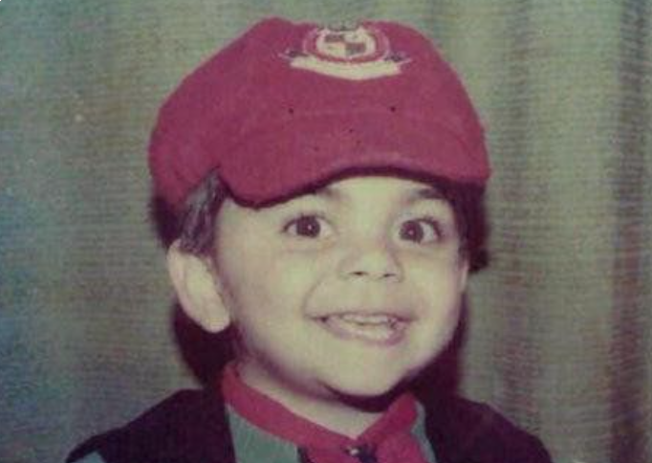



Guess who?

Slide 3
What kind of dog never bites

Slide 4
Hot Dog

Slide 5
How many apples can you eat on empty stomach

Slide 6
Only one

Slide 7

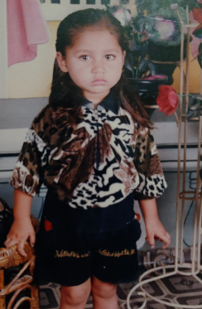
Whos this innocent?

Slide 8
Which table doesn’t have legs?

Slide 9
Vegetable

Slide 10
Why is river rich?

Slide 11
It has two banks

Slide 12
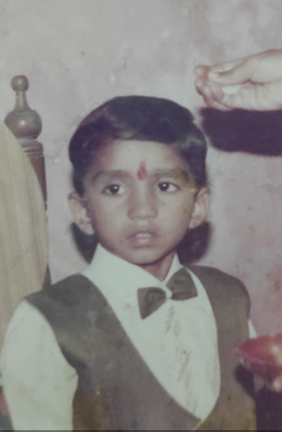
Pehchan koun?

Slide 13
What is
3/7 chicken, 2/3 cat and 2/4 goat?

Slide 14
Chicago

Slide 15
A man dies of old age on his 25 birthday. How is this possible?

Slide 16
He was born on February 29th

Slide 17
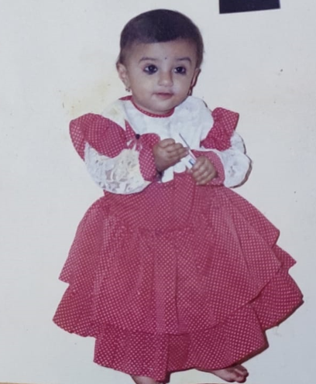
Tumhi andaj lavu sakata?

Slide 18
What does this mean?
I RIGHT I

Slide 19
Right between the eyes

Slide 20
What kind of running means walking?

Slide 21
Running out of gas

Slide 22
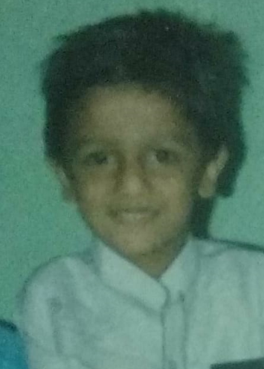
Guess who?

Slide 23
What five-letter word becomes shorter when you add two letters to it?

Slide 24
Short

Slide 25
What can you hold in your left hand but not in your right?

Slide 26
Your right elbow

Slide 27
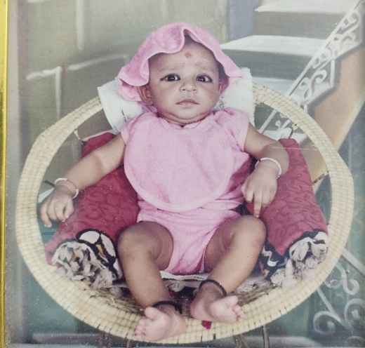
Kid of the Day

Slide 28
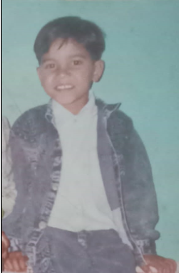
Guess who?

